Slide 1
Implementing Dynamic Foot Shape Models to Improve Spacesuit Boot Fit
Abhishektha (Abhi) Boppana | PhD Thesis Defense
Mar 30 2022

Slide 2
Thesis Committee
Allison Anderson, PhD - CU Boulder Aerospace Engineering Sciences
Daniel Feeney, PhD - BOA Technology
Rodger Kram, PhD - CU Boulder Integrative Physiology
Torin Clark, PhD - CU Boulder Aerospace Engineering Sciences
David Klaus, PhD - CU Boulder Aerospace Engineering Sciences
Notes:
Dan: biomechanics research engineer

Slide 3
Motivation
Planetary exploration and spacesuit injury incidence

Slide 4
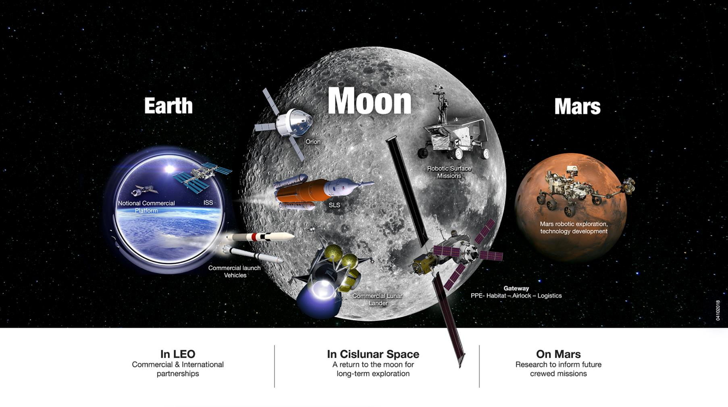
Notes:
The future of crewed space exploration is planetary.

Slide 5
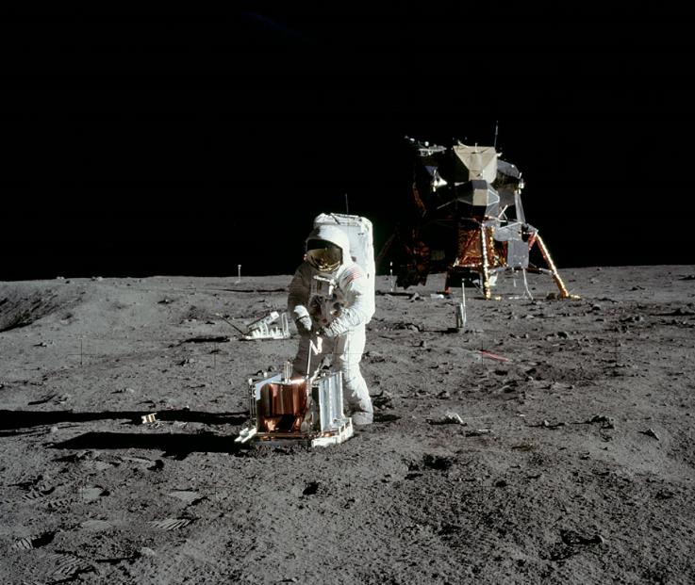
Planetary Exploration
“Success of planetary exploration depends on the ability of humans to work on and explore the surface”¹
EVA: Extravehicular Activity
Limited EVA experience
78 hours over 6 Apollo missions²
1.8 km longest traverse (Apollo 12)
Buzz Aldrin performing EVA tasks on Apollo 11 (nasa.gov)
¹Drake BG, Watts KD. Human Exploration of Mars Design Reference Architecture 5.0 (2014). NASA/SP-2009-566-ADD2.
²Portree, D. S., and Trevino, R. C., Walking to Olympus: An EVA Chronology, NASA History Office, Washington, DC, 1997.
Notes:
Lot of text on slides
Cut down text
Ex: last bullet point, only thing important is 78 hours and 1.8km
caption

Slide 6
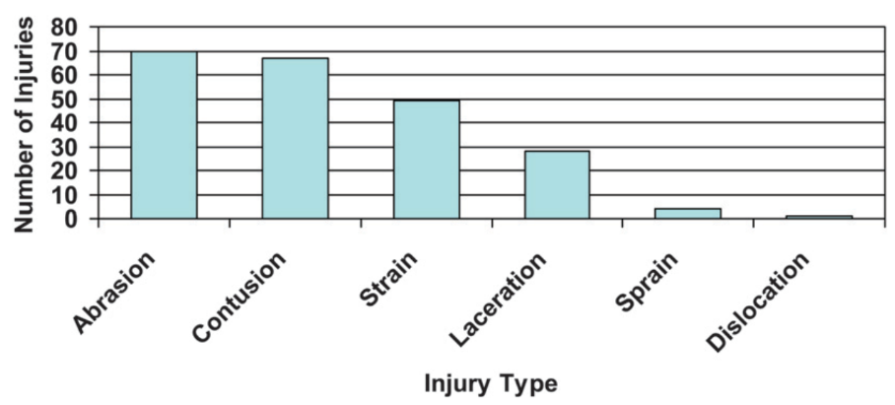
EVA Injury Incidence
EVA spacesuit components are the leading source of in-flight injuries¹
Injuries reported both in-flight and during ground-based training and evaluation sessions
Contact Injuries
Musculoskeletal Injuries
In-flight injuries throughout the U.S. space program. Modified from Scheuring et al. 2009¹
¹Scheuring, R. A., Mathers, C. H., Jones, J. A., and Wear, M. L., “Musculoskeletal Injuries and Minor Trauma in Space: Incidence and Injury Mechanisms in U.S. Astronauts,” Aviation Space and Environmental Medicine, Vol. 80, No. 2, 2009, pp. 117–124.

Slide 7
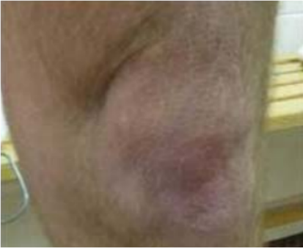
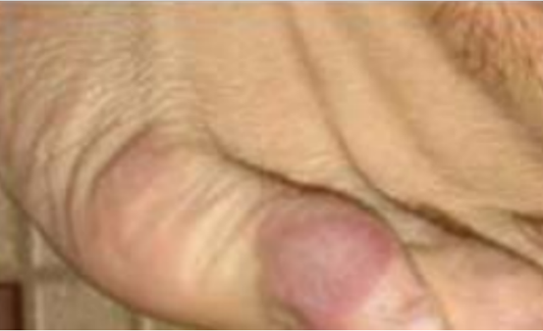
EVA Injury Incidence
EVA spacesuit components are the leading source of in-flight injuries¹
Injuries reported both in-flight and during ground-based training and evaluation sessions
Examples of lower-body spacesuit injury occurring during on-ground training and evaluation
¹Scheuring, R. A., Mathers, C. H., Jones, J. A., and Wear, M. L., “Musculoskeletal Injuries and Minor Trauma in Space: Incidence and Injury Mechanisms in U.S. Astronauts,” Aviation Space and Environmental Medicine, Vol. 80, No. 2, 2009, pp. 117–124.
Notes:
Mixing fatigue and injury

Slide 8
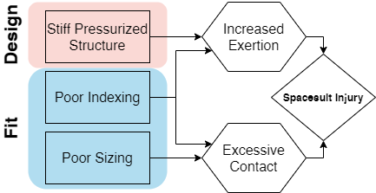
Hypothesized Injury Mechanisms
Notes:
Stiff, pressurized structure
Need to overcome pressure forces to bend suit joints
Poor indexing:
Misaligned joint centers between operator and spacesuit
Poor sizing
Gaps leading to excessive contact
Limit mobility when undersized

Slide 9
Background
Limits in spacesuit mobility and fit for planetary surface exploration

Slide 10
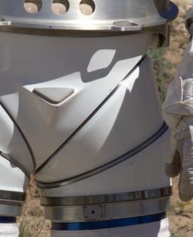
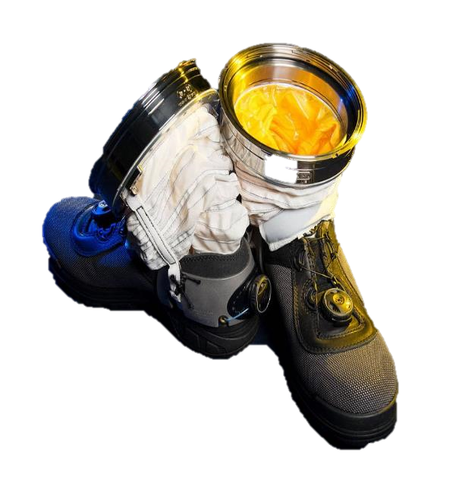
A Stiff, Pressurized Structure
Bending pressurized cylinder reduces volume at joint, hence requiring additional force¹
Constant volume joints reduce force needed
Examples include²:
Convolutes
Bellows
Hard Joints
Left: Hard joint on MK III spacesuit
Right: Convoluted ankle joint on spacesuit boot
¹Newman, D., and Barratt, M., “Life Support and Performance Issues for Extravehicular Activity (EVA),” Fundamentals of Space Life Sciences, edited by S. Churchill, Krieger Publishing Co., Malabar, FL, 1997, pp. 1–61.
²Harris, G. L., The Origins and Technology of the Advanced Extravehicular Space Suit, American Astronautical Society, San Diego, CA, 2001.

Slide 11
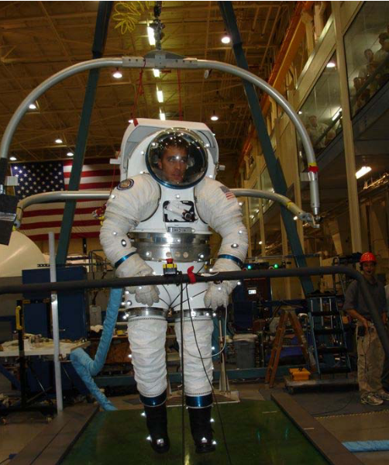
Suited Effects on Ambulation
Increased metabolic cost¹
Not fully explained by suit pressure and suit ²
Potential factors: fit, biomechanics of suit, stability
Inhibited mobility compared to unsuited³
Reduced toe and heel clearance
Decreased speed and step length
Suited ambulation test in the MK III spacesuit²
¹Norcross, J. R., Lee, L. R., Clowers, K. G., Morency, R. M., Desantis, L., DeWitt, J. K., Jones, J. A., Voss, J. R., and Gernhardt, M. L., “Feasibility of Performing a Suited 10-Km Ambulation on the Moon - Final Report of the EVA Walkback Test (EWT),” NASA/TP-2009-214796, NASA Johnson Space Center, Houston, TX, 2009.
²Norcross, J., Clowers, K., Clark, T., Harvill, L., Morency, R. M., Stroud, L. C., Vos, J. R., and Gernhardt, M. L., “Metabolic Costs and Biomechanics of Level Ambulation in a Planetary Suit,” NASA/TP-2010-216115, NASA Johnson Space Center, Houston, TX, 2010.
³Cullinane, C. R., Rhodes, R. A., and Stirling, L. A., “Mobility and Agility during Locomotion in the Mark III Space Suit,” Aerospace Medicine and Human Performance, Vol. 88, No. 6, 2017, pp. 589–596
Notes:
Lot of text /duplication on this slide
First bullet: just increases metabolic cost
Tie second bullet into first
Don’t need stride and step length
Third bullet: just inhibited mobility

Slide 12
Spacesuit Fit Limitations
Apollo EVA suits custom tailored¹
Current suits must be fit with variously sized components¹
Goal: design for 5th percentile female-95th percentile male²
Baseline suit fit derived from operator’s linear anthropometry using proprietary suiting algorithms, then operator feedback used to optimize suit fit²
¹Harris, G. L., The Origins and Technology of the Advanced Extravehicular Space Suit, American Astronautical Society, San Diego, CA, 2001.
²Kim, K. H., Young, K., Benson, E., Jarvis, S., Vu, L., Hernandez, Y., and Rajulu, S., “Human Modeling Tools for Spacesuit and Hardware Design and Assessment,” DHM and Posturography, edited by S. Scataglini and P. Gunther, Academic Press, 2019, pp. 613–625.
Notes:
Based on the hardware produced during the EMUprogram, the actual anthropometric range that could adequatelyfit in the EMU ranged from a 40th percentile female to a95th percentile male. The appropriate suit component sizing for each crewmember was based on the linear and circum-ferential measurements of body shapes, including stature, inter-scye breadth, bi-deltoid breadth, vertical trunk diameter,and other critical dimensions
Sizing rings and tension straps to adjust length
Pads for additional comfort and indexing
What measurement to use for percentiles?
EMU actual accommodation: 40th female-95th percentile male²
-last bullet: make into an equation or split up
-feedback: circular
Careful about fit vs. size
Slide rather than a paragraph

Slide 13
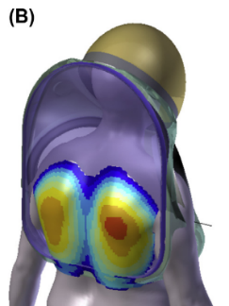
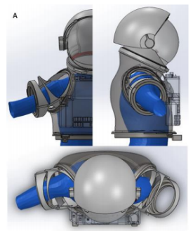
Body-Shape Models for Spacesuits
Linear measurements don’t always represent body shape
Manikins overlaid on 3D suit models to check interference¹
Dynamic models to capture shape changes through motion^{1,2}
Current efforts only capture low-frequency motions
Limited integration into suit design and fit
Dynamic capture of shoulder shape² (top) and testing with hard upper torso (bottom)^{1,2}
¹Kim, K. H., Young, K., Benson, E., Jarvis, S., Vu, L., Hernandez, Y., & Rajulu, S. (2019). Human modeling tools for spacesuit and hardware design and assessment. In S. Scataglini & P. Gunther (Eds.), DHM and Posturography (pp. 613–625). Academic Press.
²Kim, K. H., Young, K. S., Bernal, Y., Boppana, A., Vu, L. Q., Benson, E. A., Jarvis, S., & Rajulu, S. L. (2016). A Parametric Model of Shoulder Articulation for Virtual Assessment of Space Suit Fit. Proceedings of the 7th International Conference on 3D Body Scanning Technologies, 201–207.
Notes:
Think about if I have time to explain all the figures, maybe just stick to bottom two

Slide 14
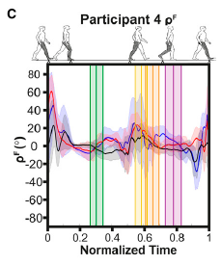
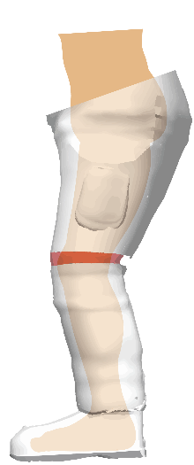
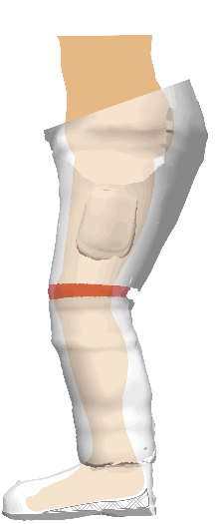
Effect of Fit on Performance
Fit metrics dynamic over gait cycle¹
Results very subject-specific, no clear trend
Lower body fit may need to be focused on foot-boot interface¹
Subjects reported heel-lift, where heel pops out of boot during heel-off
Dynamic differences femur angular velocity between the operator and spacesuit during gait¹
Heel-lift during gait, where the foot lifts inside the boot (right) at heel-off, resulting in a gap (shaded)
¹Fineman, R. A., McGrath, T. M., Kelty-Stephen, D. G., Andrew, A. F., & Stirling, L. A. (2018). Objective metrics quantifying fit and performance in spacesuit assemblies. Aerospace Medicine and Human Performance, 89(11), 985–995. https://doi.org/10.3357/AMHP.5123.2018

Slide 15
Knowledge Gaps
Few efforts to quantify fit discrepancies
Limited knowledge on dynamic body-shape changes due to motion
No existing framework for incorporating dynamic body-shape models into the spacesuit design and fit process
No studies to quantify the effect of using dynamic body-shape models versus static linear measurements on spacesuit fit and comfort
Notes:
Gap refers to physical gaps, but on this slide is knowledge gaps
Second bullet then doesn’t need limited knowledge,

Slide 16
Research Overview

Slide 17
Scope
Limit to spacesuit boot as a test case
Current boots exhibit heel-lift, a symptom of poor fit
Ambulation will be a key component of future planetary surface exploration missions
Focus on gas pressurized spacesuit designs
Mechanical counterpressure is an alternative that has not yet been implemented in operational EVA suit design

Slide 18
Hypotheses
Integrating dynamic body shape changes
into the spacesuit boot design process will:
1)mitigate factors that lead to injury
2)improve compatibility between the operator and the spacesuit
Notes:
Balance out text on this slide

Slide 19
Research Aims
Specific Aim 1: Quantify magnitude and frequency of heel-lift in spacesuit gait
Specific Aim 2: Predictively model dynamic changes in foot morphology during gait
Specific Aim 3: Define and validate a design process integrating dynamic foot morphology data for a novel spacesuit boot
Specific Aim 4: Evaluate the prototype planetary spacesuit boot for fit and comfort
Notes:
Signpost slide

Slide 20
Specific Aim 1
Quantify instances of heel-lift in spacesuit gait

Slide 21


Background
Heel-Lift: Delay in heel-off time between spacesuit and operator
No quantitative method to detect heel-lift
IMUs integration drift ¹⁻³
Drift correction techniques not evaluated in spacesuits
Objective: Evaluate ability of IMUs and drift-correction techniques to quantify the frequency and magnitude of heel-lift
Heel-lift during gait, where the foot lifts inside the boot (right) at heel-off, resulting in a gap (shaded)
¹Bertrand, P. J., Anderson, A., Hilbert, A., & Newman, D. (2014). Feasibility of Spacesuit Kinematics and Human-Suit Interactions. 44th International Conference on Environmental Systems.
²Shen, Y. Y., & Anderson, A. P. (2019). Extended Kalman Filter for Magnetometer-Free Estimation of Spacesuit Wearer Joint Kinematics Using Inertial Measurements. FUSION 2019 - 22nd International Conference on Information Fusion
³Shen, Y.-Y., Wood, S., & Anderson, A. P. (2020, January 6). Evaluation of Wearable Inertial Sensors for Spacesuit Design Applications Using Hardware-in-the-Loop Simulation. AIAA Scitech 2020 Forum.
Notes:
Make sure to refer to the leg as shank here to set-up for terminology in this section

Slide 22
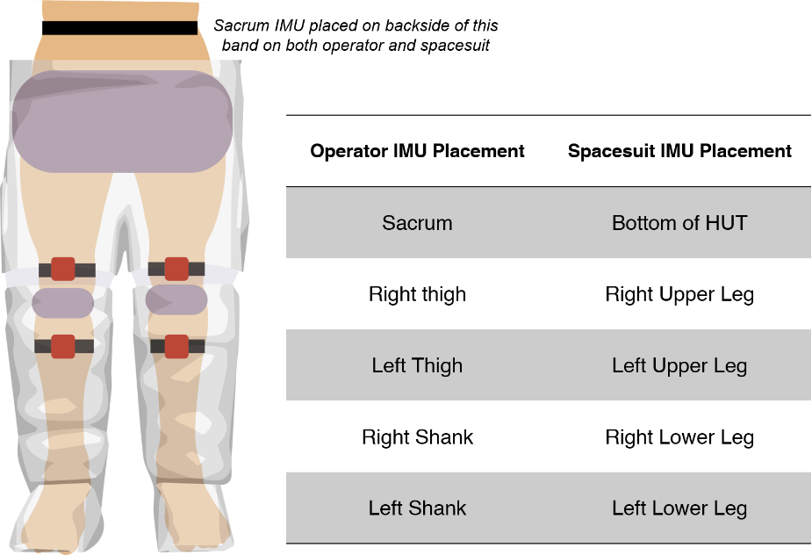
Experimental Data
Collected by Fineman et al. 2018¹
N=3, all male
IMUs collected acceleration and orientation information on both operator’s and spacesuit’s pelvis, thigh, shank
Placement of IMUs (red) and padding (gray) in suit assembly.
¹Fineman, R. A., McGrath, T. M., Kelty-Stephen, D. G., Andrew, A. F., & Stirling, L. A. (2018). Objective metrics quantifying fit and performance in spacesuit assemblies. Aerospace Medicine and Human Performance, 89(11), 985–995.
Notes:
Specifically mention Shank and SLL

Slide 23
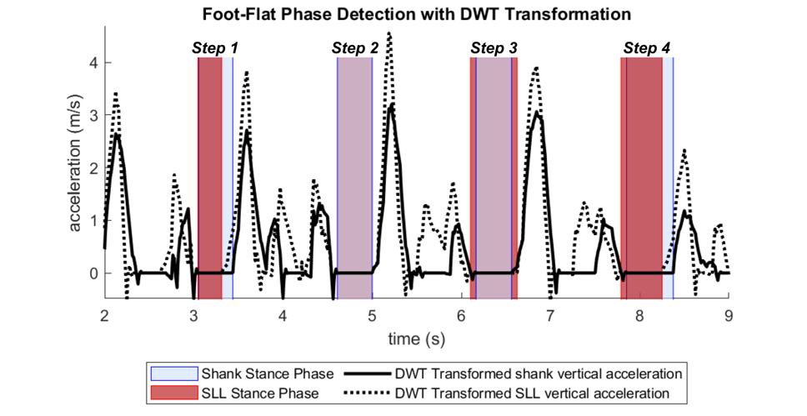
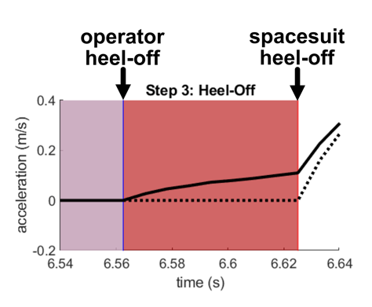
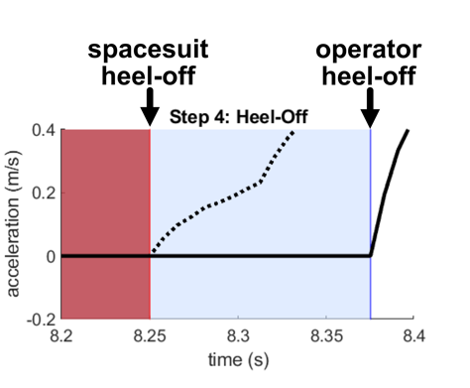
Heel-Off Detection
Discrete Wavelet Thresholding of shank vertical acceleration signal¹
Stance phase detected as period of zero vertical acceleration per each step
Heel-off detected as end of stance phase
Operator heel-off prior to suit heel-off may indicate heel-lift
¹Ji, N., Zhou, H., Guo, K., Samuel, O. W., Huang, Z., Xu, L., & Li, G. (2019). Appropriate mother wavelets for continuous gait event detection based on time-frequency analysis for hemiplegic and healthy individuals. Sensors (Switzerland), 19(16), 1–18.
Notes:
Annotate heel-off points on shaded regions
Maybe split spacesuit and human graphs, animate them together

Slide 24
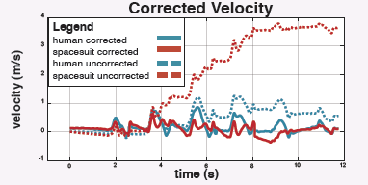
Heel-Lift Measurement
Zero-Velocity/Zero-Position Update at heel-off:
shank is stationary vertically
“zeroed” in position on ground
Quantified reduction in drift between each step:
At 0.04s, drift may already exceed 1cm in spacesuit-mounted IMU
Drift correction from zero-velocity updates
¹Feliz, R., Zalama, E., & García-Bermejo, J. G. (2009). Pedestrian tracking using inertial sensors. Journal of Physical Agents, 3(1), 35–42.

Slide 25
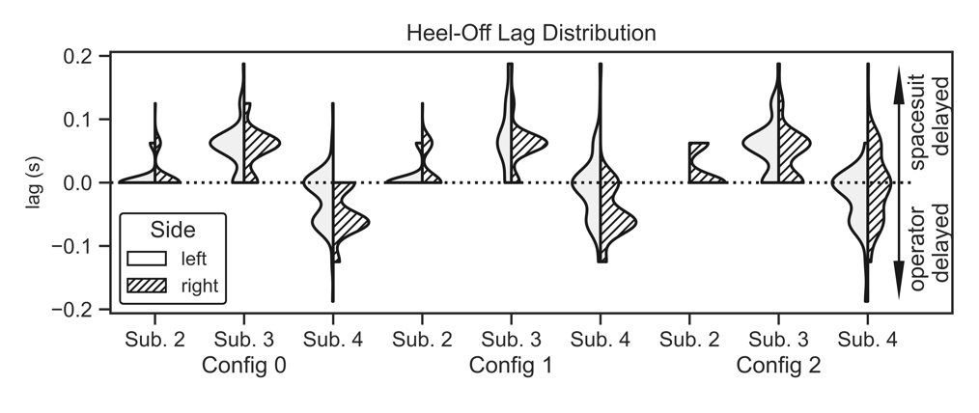
Results
Spacesuit-delayed heel-off may suggest heel-lift
Present in all subjects
Operator-delayed heel-off (Sub. 4) theoretically impossible
Distribution of heel-off lags across subjects and configurations
Notes:
Talk through plot – mention the
Maybe animate the pressure-forces effect
Overlay configurations diagram over the 1,2,3 groups
Show that configuration did not mitigate the issues

Slide 26
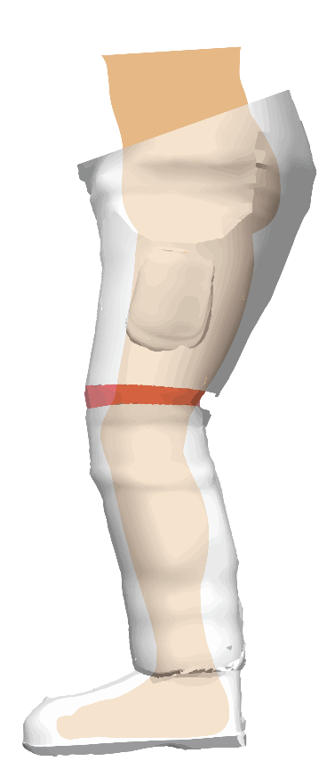
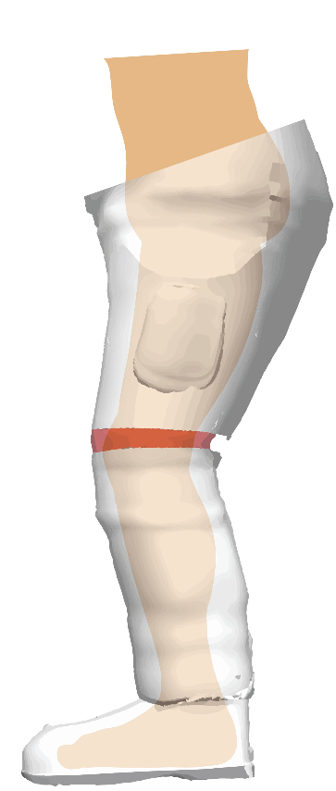
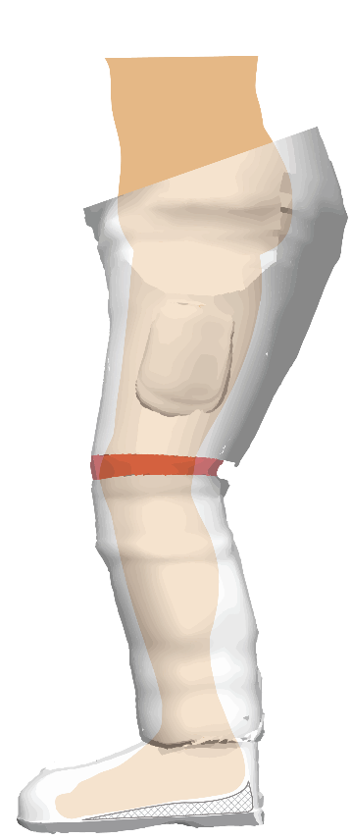
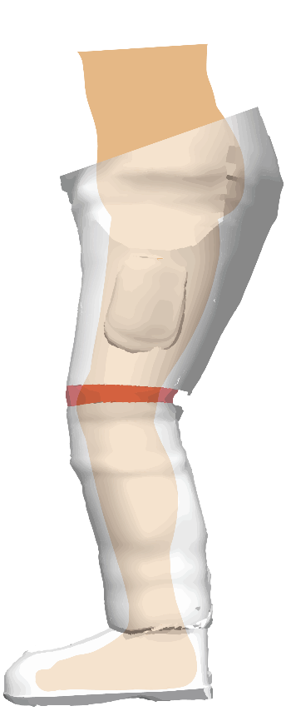
Results
Operator-delayed heel-off may be due to spacesuit’s pressure forces extending lower leg
Subject 4 had largest lower leg anthropometry
Subject 4 had higher relative coordination metric¹; could be indicative of tighter boot fit
Vertical acceleration of SLL IMU prior to shank IMU
Vertical acceleration of shank IMU prior to SLL IMU
Spacesuit mechanics that result in negative (left) and positive (right) heel-off lag
¹Fineman, R. A., McGrath, T. M., Kelty-Stephen, D. G., Andrew, A. F., & Stirling, L. A. (2018). Objective metrics quantifying fit and performance in spacesuit assemblies. Aerospace Medicine and Human Performance, 89(11), 985–995.
Notes:
Talk through plot – mention the
Maybe animate the pressure-forces effect
Overlay configurations diagram over the 1,2,3 groups
Show that configuration did not mitigate the issues

Slide 27
Summary
Conclusions:
IMUs mounted on spacesuit may be subject to noise from pressure forces
Zero Velocity Updates do not reduce drift enough to quantify heel-lift
Future work to evaluate contact sensors for direct detection of heel-lift instances
Notes:
Clarify ZVUs for spacesuit mounted IMUs

Slide 28
Specific Aim 2
Predictively model dynamic changes in foot morphology during gait

Slide 29
Background
Novel spacesuit boot design requires understanding of foot shape
Foot shape is highly variable in population by sex¹⁻³, age⁴, weight⁵, and while loaded during stance phase^{6,7}
Existing technology to capture dynamic foot shape is expensive and not developed around a treadmill⁷
No statistical shape models developed to predict foot shape across population and during motion
¹Wunderlich, R. E., & Cavanagh, P. R. (2001). Gender differences in adult foot shape: Implications for shoe design. Medicine and Science in Sports and Exercise, 33(4), 605–611.
²Krauss, I., Grau, S., Mauch, M., Maiwald, C., & Horstmann, T. (2008). Sex-related differences in foot shape. Ergonomics, 51(11), 1693–1709.
³Krauss, I., Valiant, G., Horstmann, T., & Grau, S. (2010). Comparison of female foot morphology and last design in athletic footwear-are men’s lasts appropriate for women? Research in Sports Medicine, 18(2), 140–156.
⁴Tomassoni, D., Traini, E., & Amenta, F. (2014). Gender and age related differences in foot morphology. Maturitas, 79(4), 421–427.
⁵Price, C., & Nester, C. (2016). Foot dimensions and morphology in healthy weight, overweight and obese males. Clinical Biomechanics, 37, 125–130.
⁶Kouchi, M., Kimura, M., & Mochimaru, M. (2009). Deformation of foot cross-section shapes during walking. Gait and Posture, 30(4), 482–486.
⁷Barisch-Fritz, B., Schmeltzpfenning, T., Plank, C., & Grau, S. (2014). Foot deformation during walking: Differences between static and dynamic 3D foot morphology in developing feet. Ergonomics, 57(6), 921–933.
Notes:
Lead off with this explicitly (add bullet point): Mention how designing a better fitting boot requires a thorough understanding of foot shape. Achieve good resolution limited by current efforts, need to motivate the gap in spacesuit boot design (link to terrestrial boot definciens like here)

Slide 30
Objectives
Develop a low-cost 4D scanning system capable of capturing foot shape around a treadmill
Create a predictive model of foot shape changes across the dorsal surface during stance phase
Identify specific areas of the foot that change shape during stance phase
Correlate changes in foot shape across large-scale population foot measurements

Slide 31
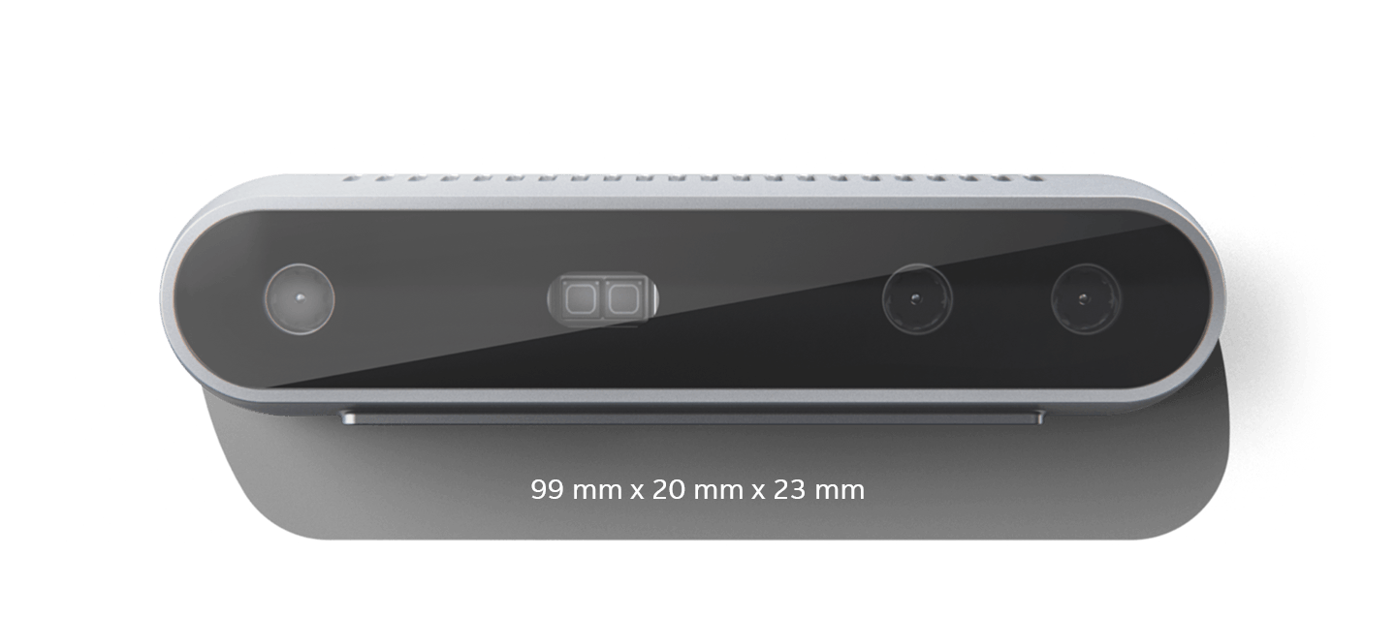
Custom 4D Scanning System
Intel RealSense D415:
3D point clouds at 90 frames-per-second
$150
Range: 15cm-10m
Accuracy: ~2% of range
DynaMo¹: published software library to use multiple cameras for dynamic body shape capture
¹Boppana and Anderson. DynaMo: Dynamic Body Shape and Motion Capture with Intel RealSense Cameras (2019). Journal of Open Source Software.

Slide 32
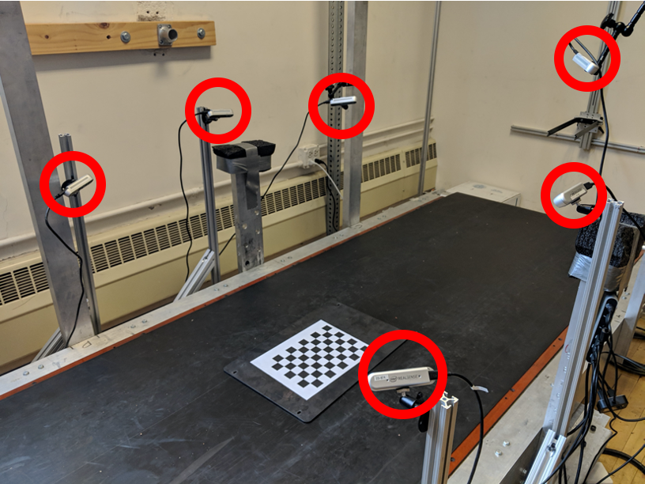
Data Collection Procedures
30 Subjects (15m/15f)
Stratified sampling by height for diversity in foot length
Subject anthropometry
Height, weight, foot length, foot width, arch length
Foot Preparation
Left foot covered in black sock
Right foot marked with 18 reflective markers
Subject walks on treadmill at 1.4 m/s
1 minute warm-up
Data collection for 10 seconds
Review and repeat if necessary
Data collection treadmill in CU Locomotion Laboratory
Notes:
Link to the github

Slide 33
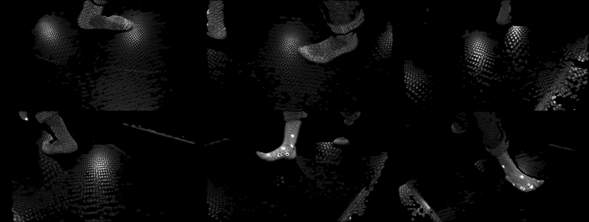
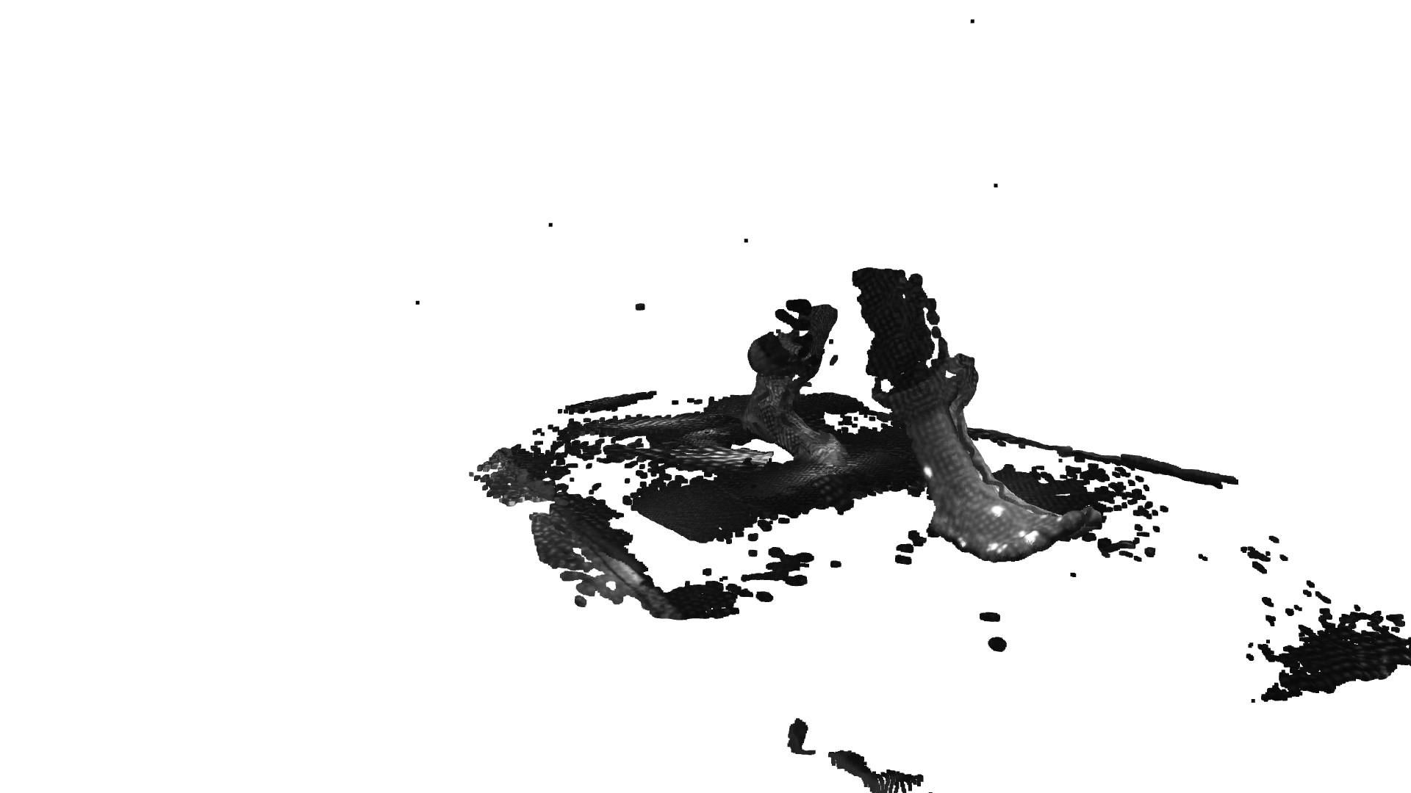
1
2
3
4
5
6
Notes:
Review order of slides

Slide 34
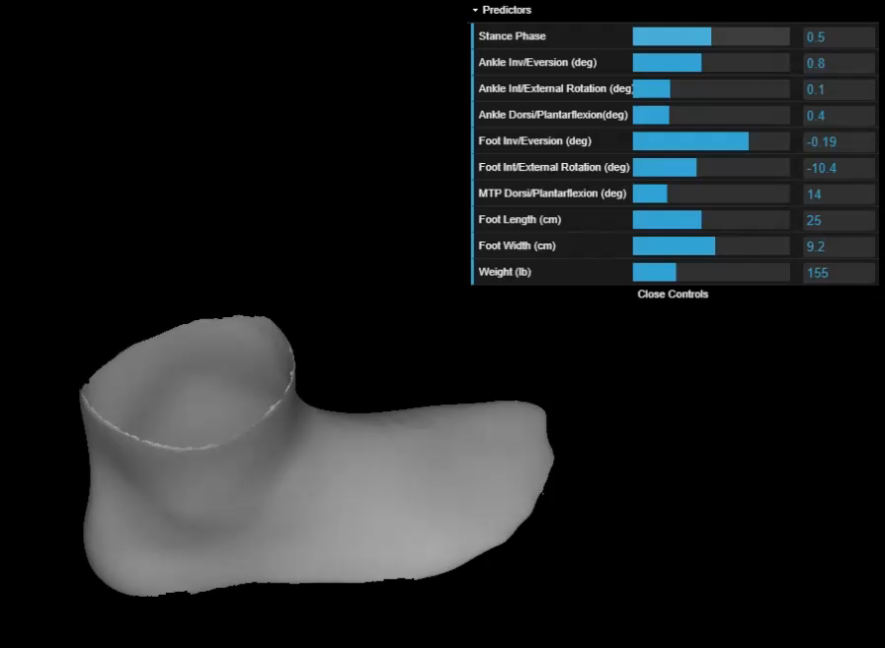
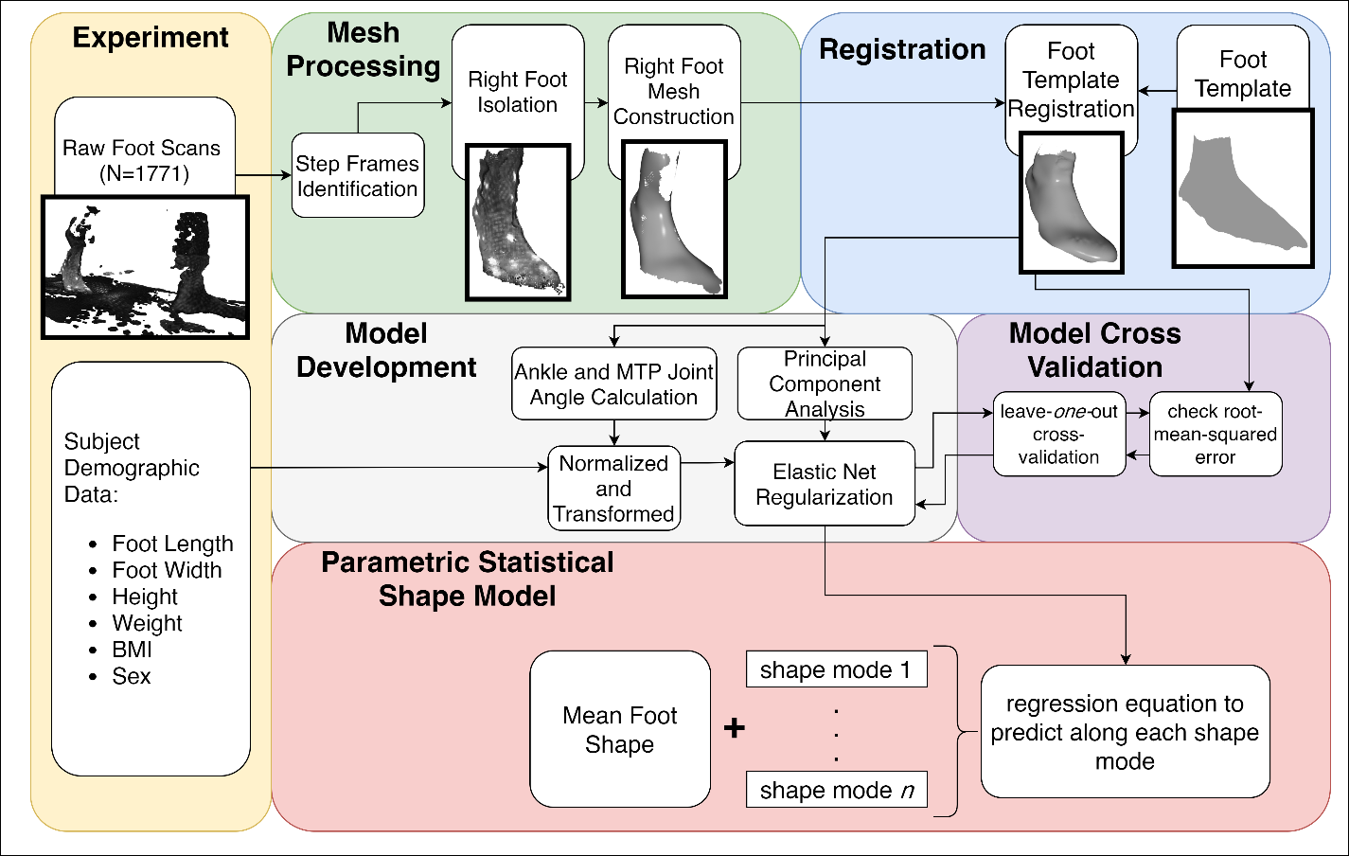
Foot Shape Model
Final model predicts 8 principal components (95% of total variance)
Sex not found to be a predictive variable
Accuracy: 5.2 mm ± 2.0 mm
Play with the model yourself at:
http://tiny.cc/dynafootModel
¹Boppana, A., & Anderson, A. P. (2020). Dynamic foot morphology explained through 4D scanning and shape modeling. ArXiv:2007.11077.
Notes:
Highly cross-correlated predictors removed
Arch-length
Body mass index
height
Mention that these are distributions, show how similar they are

Slide 35
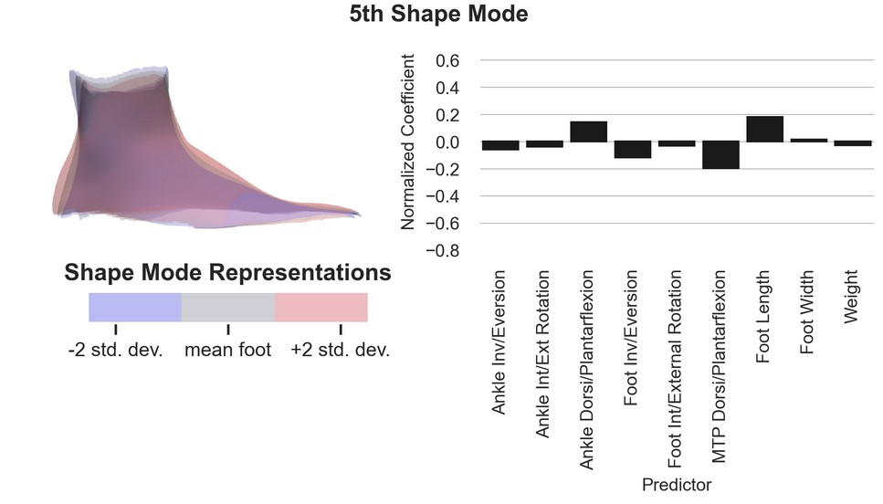
Heel Shape Changes
Heel goes from a rounded shape to a sharp shape after heel-off
Explained by soft-tissue off-loading

Slide 36
Instep Shape Changes
Instep height drops after heel-off
Explained by medial-longitudinal arch (MLA) height dynamics ^{1,2}
Can the magnitude of instep height be characterized across the population?
¹J. H. Hicks, “The mechanics of the foot II. The plantar aponeurosis and the arch,” Journal of Anatomy, vol. 88, no. 1, pp. 25–30, 1954.
²R. F. Ker, M. B. Bennett, S. R. Bibby, R. C. Kester, and R. McN. Alexander, “The spring in the arch of the human foot,” Nature, vol. 325, no. 6100, pp. 147–149, Jan. 1987.

Slide 37
Instep Height Analysis
What is the magnitude of instep height change in stance phase?
Does dynamic instep height correlate to static foot measurements?
Drive footwear design
Improve fit
Collaboration with Volumental AB: 1.2 million footwear scans¹
¹Jurca, A., Žabkar, J., & Džeroski, S. (2019). Analysis of 1.2 million foot scans from North America, Europe and Asia. Scientific Reports, 9(1), 1–10.

Slide 38
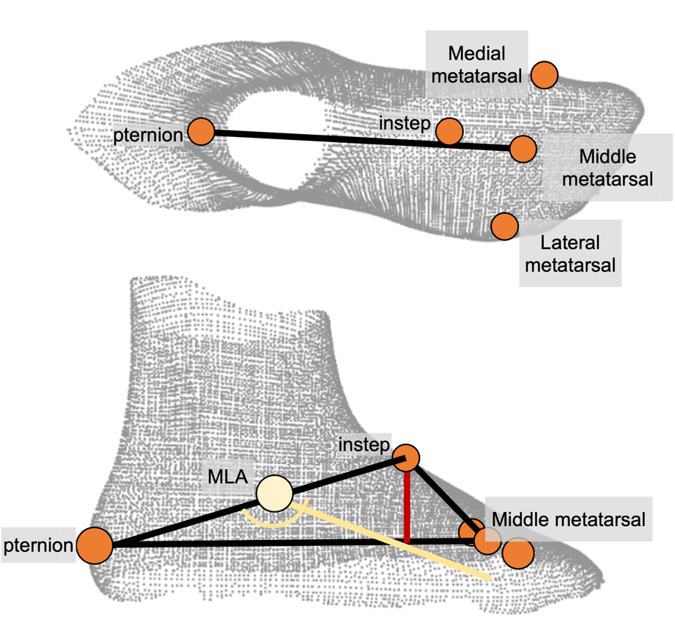
Instep Height Measurement
New methodology to measure instep height without plantar foot surface

Slide 39
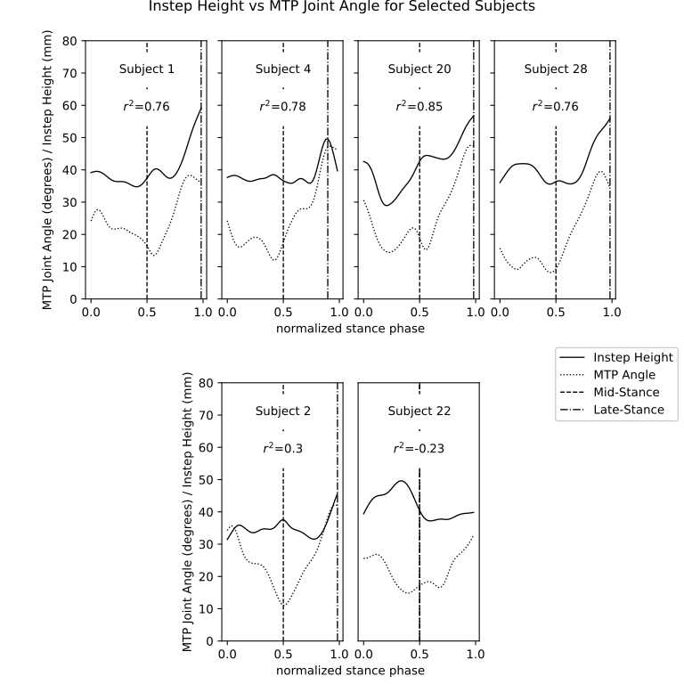
Dynamic Instep Height Results
Instep height correlated against MTP angle to assess change over stance phase
25/30 subjects: high correlation (r²=0.73±0.10)
Mean instep height change: 15mm±4mm
5/30 subjects: low correlation (r²=0.11±0.36)
No observable differences in foot shape in this group
3/5 subjects still had rise in instep height in late stance
normalized stance phase

Slide 40
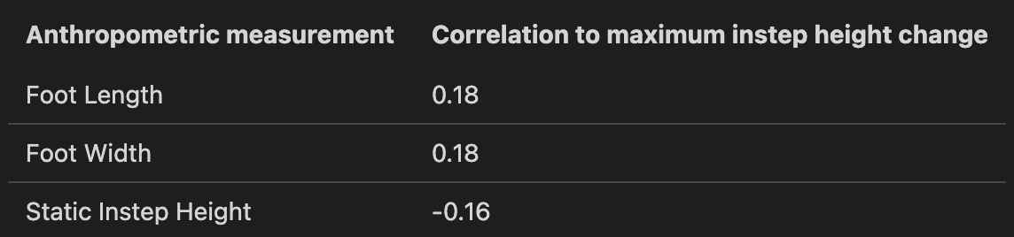
Results
Low correlations between maximum instep height change and foot anthropometrics
Need for adjustable lacing: accommodates dynamic instep height variability through tension

Slide 41
Summary
Statistical shape model created to predict dynamic foot shape during gait from subject anthropometry and kinematics
Model shows dynamic changes at instep and heel that can be targeted in design to reduce heel-lift
Low correlations between the dynamic instep height and subject anthropometrics suggest that adjustability is needed to accommodate static and dynamic instep height in footwear design

Slide 42
Specific Aim 3
Define a design process integrating dynamic foot morphology data for a novel spacesuit boot

Slide 43
Background
Previous spacesuit boot designs modified terrestrial shoes and iterated based on subjective feedback
Spacesuit boot design should match the required operator motions for the intended actions, and be sized for the intended population
No clear process for integrating all available data, including dynamic foot morphology data, into the spacesuit boot design process

Slide 44
Objectives
Literature review of existing foot shape and mobility knowledge
Development of a design framework to design a more compatible spacesuit boot
Design and construction of a spacesuit boot prototype leveraging the design framework

Slide 45
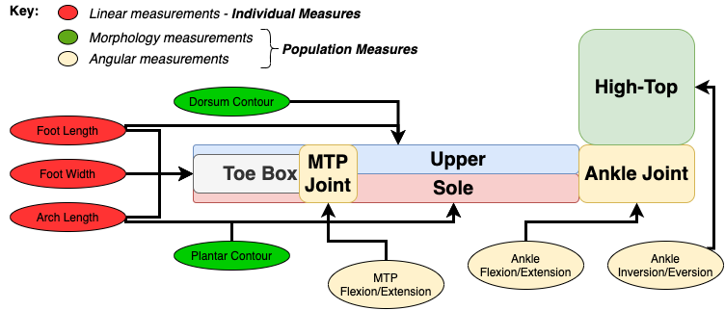
Boot Design Framework
Individual linear measurements to be used to define sizing elements
Morphology and angular measurements define the overall design of the boot
¹Boppana, A., & Anderson, A. P. (2020). A Biomechanical Design Framework to Improve Spacesuit Boot Fit. 50th International Conference on Environmental Systems.
Notes:
Animate the different bullet points to diagram
Make sure to go over the different boot parts, break it down for the audience

Slide 46
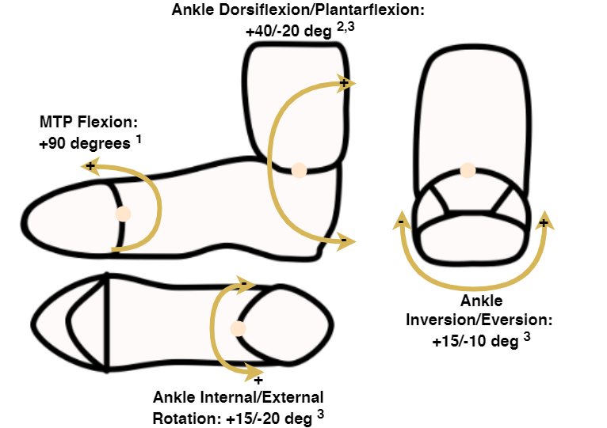
Nominal Foot Mobility Values
Nominal values taken from mobility while walking on uneven² and sloped surfaces³
Design should allow for joints to stabilize and provide power
Ankle joint dorsi/plantarflexion consistent with NASA requirements⁴
Ideal foot mobility, with references cited below
¹Mann, R. A., & Hagy, J. L. (1979). The function of the toes in walking and running. Clinical Orthopaedics & Related Research, July(142), 24–29.
²Voloshina, A. S., Kuo, A. D., Daley, M. A., & Ferris, D. P. (2013). Biomechanics and energetics of walking on uneven terrain. Journal of Experimental Biology, 216(21), 3963–3970.
³Wannop, J. W., Worobets, J. T., Ruiz, R., & Stefanyshyn, D. J. (2014). Footwear traction and three-dimensional kinematics of level, downhill, uphill and cross-slope walking. Gait and Posture, 40(1), 118–122.
⁴NASA. (2019). Small Business Innovation Research (SBIR) & Small Business Technology Transfer (STTR) Fiscal Year 2019 General Solicitation.
Notes:
Verbally say what the requirements lack in NASA (MTp joint, other ankle mobility)

Slide 47
Novel Spacesuit Boot Design Process
Limit scope to pressure bladder:
Closest layer to wearer
Must be deformed to allow for motion
Restraint layer not included after discussions with spacesuit engineers
Design will focus on:
Upper and lacing to accommodate instep height variability
Heel counter to secure heel during heel-off
Other elements borrowed from current spacesuit boot design

Slide 48
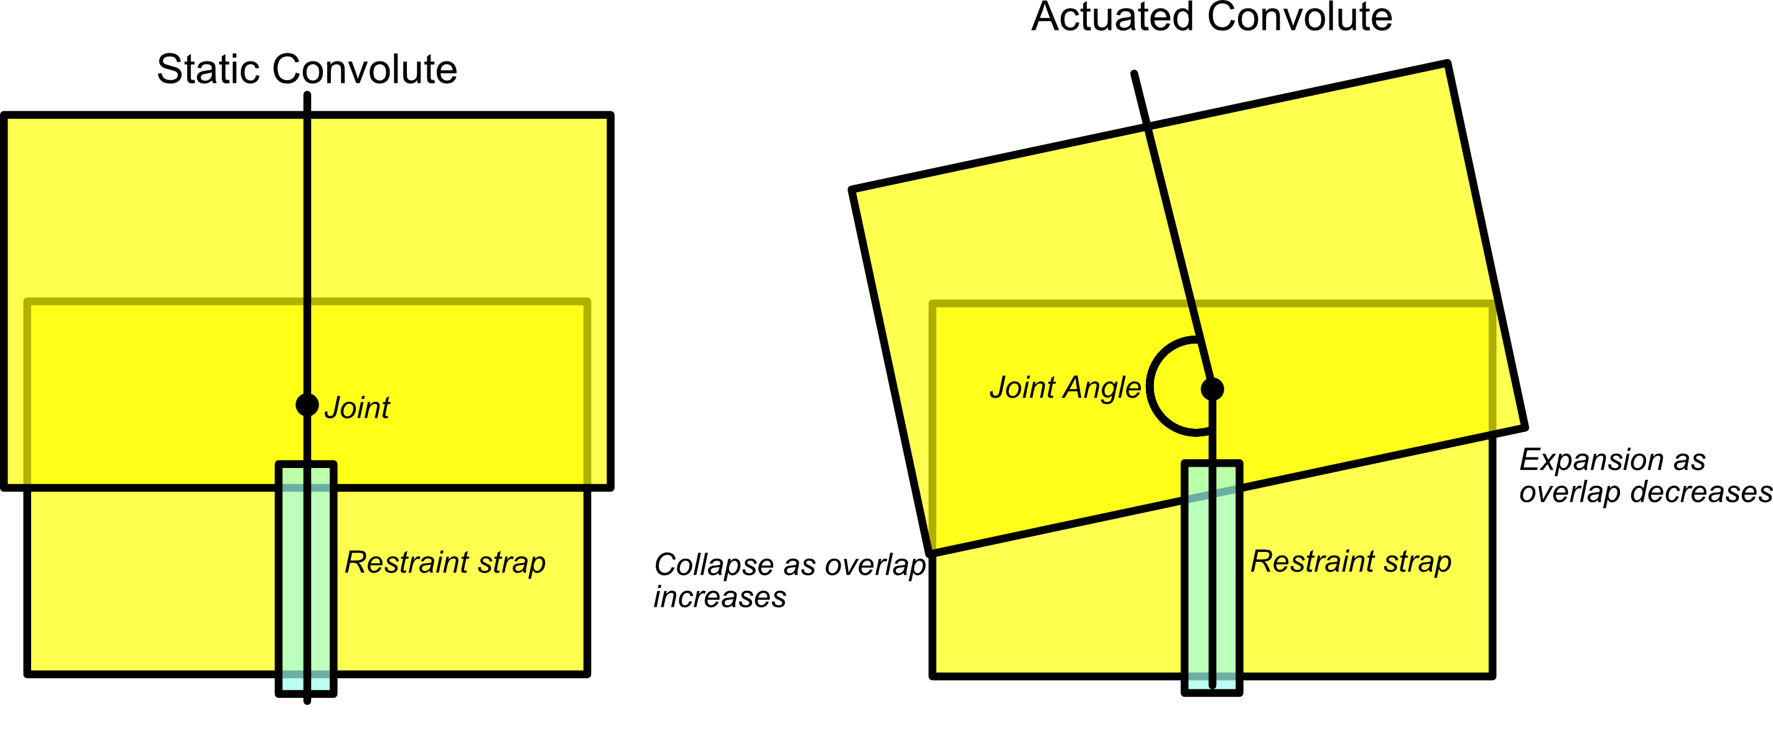
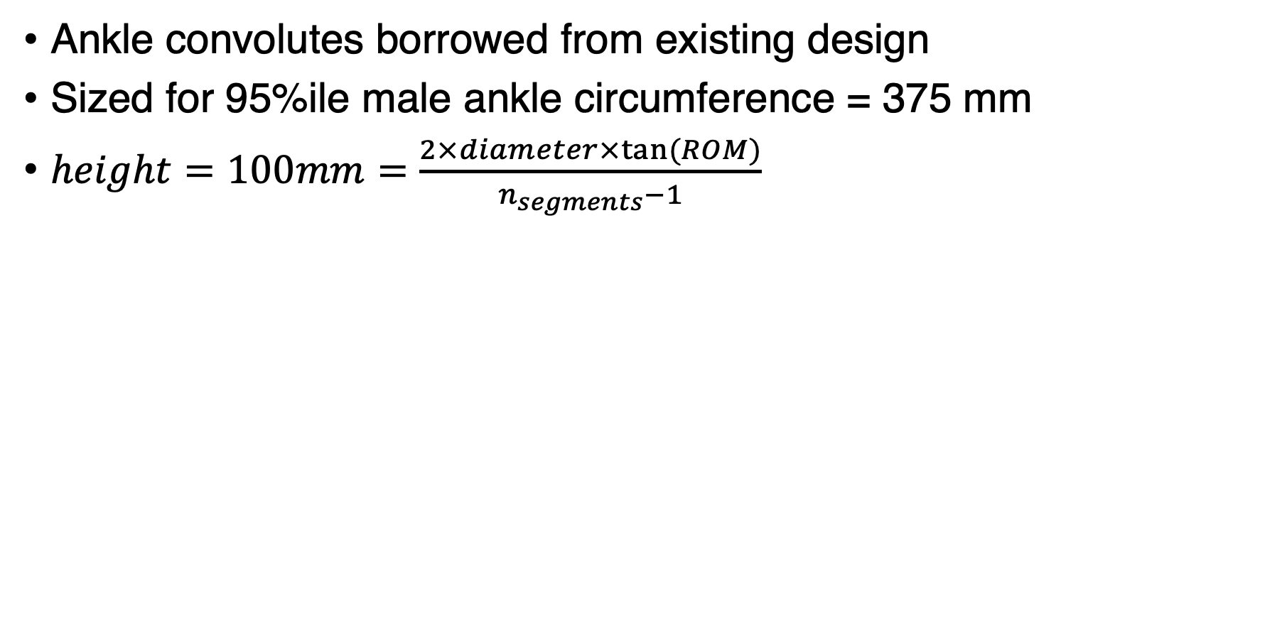
Ankle Convolute Design
Ankle convolutes borrowed from existing design
Sized for 95%ile male ankle circumference = 375 mm
$height=100mm=\frac{2×diameter×tan⁡(ROM)}{n_{segments}−1}$

Slide 49
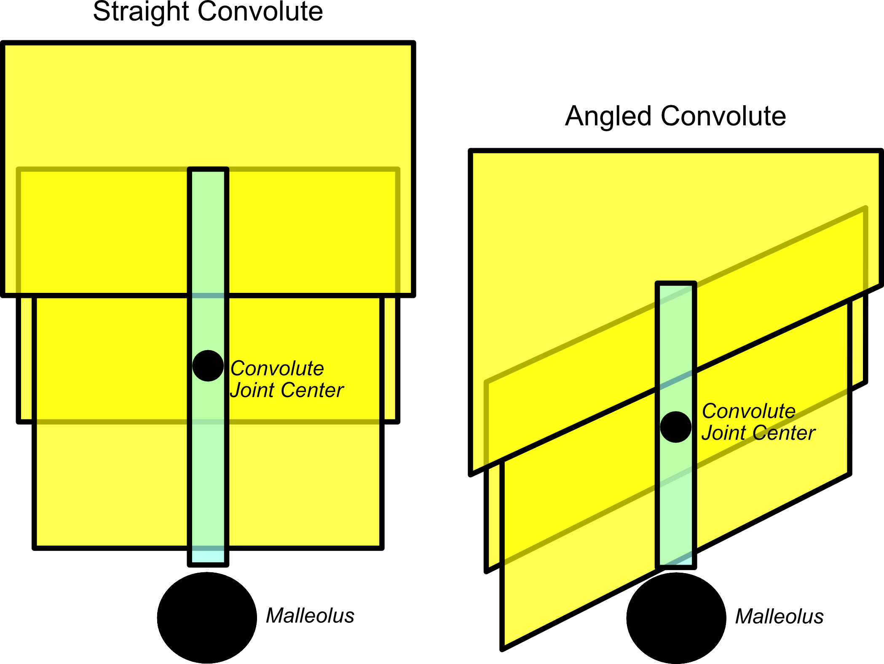
Ankle Convolutes Joint Center
Angling convolutes allows for improved indexing with closer joint center alignment

Slide 50
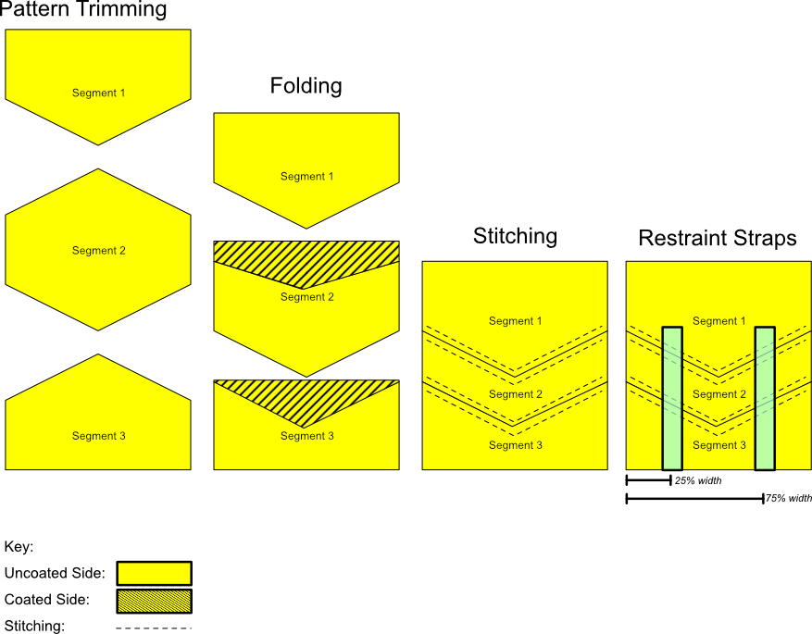
Ankle Convolute Construction

Slide 51
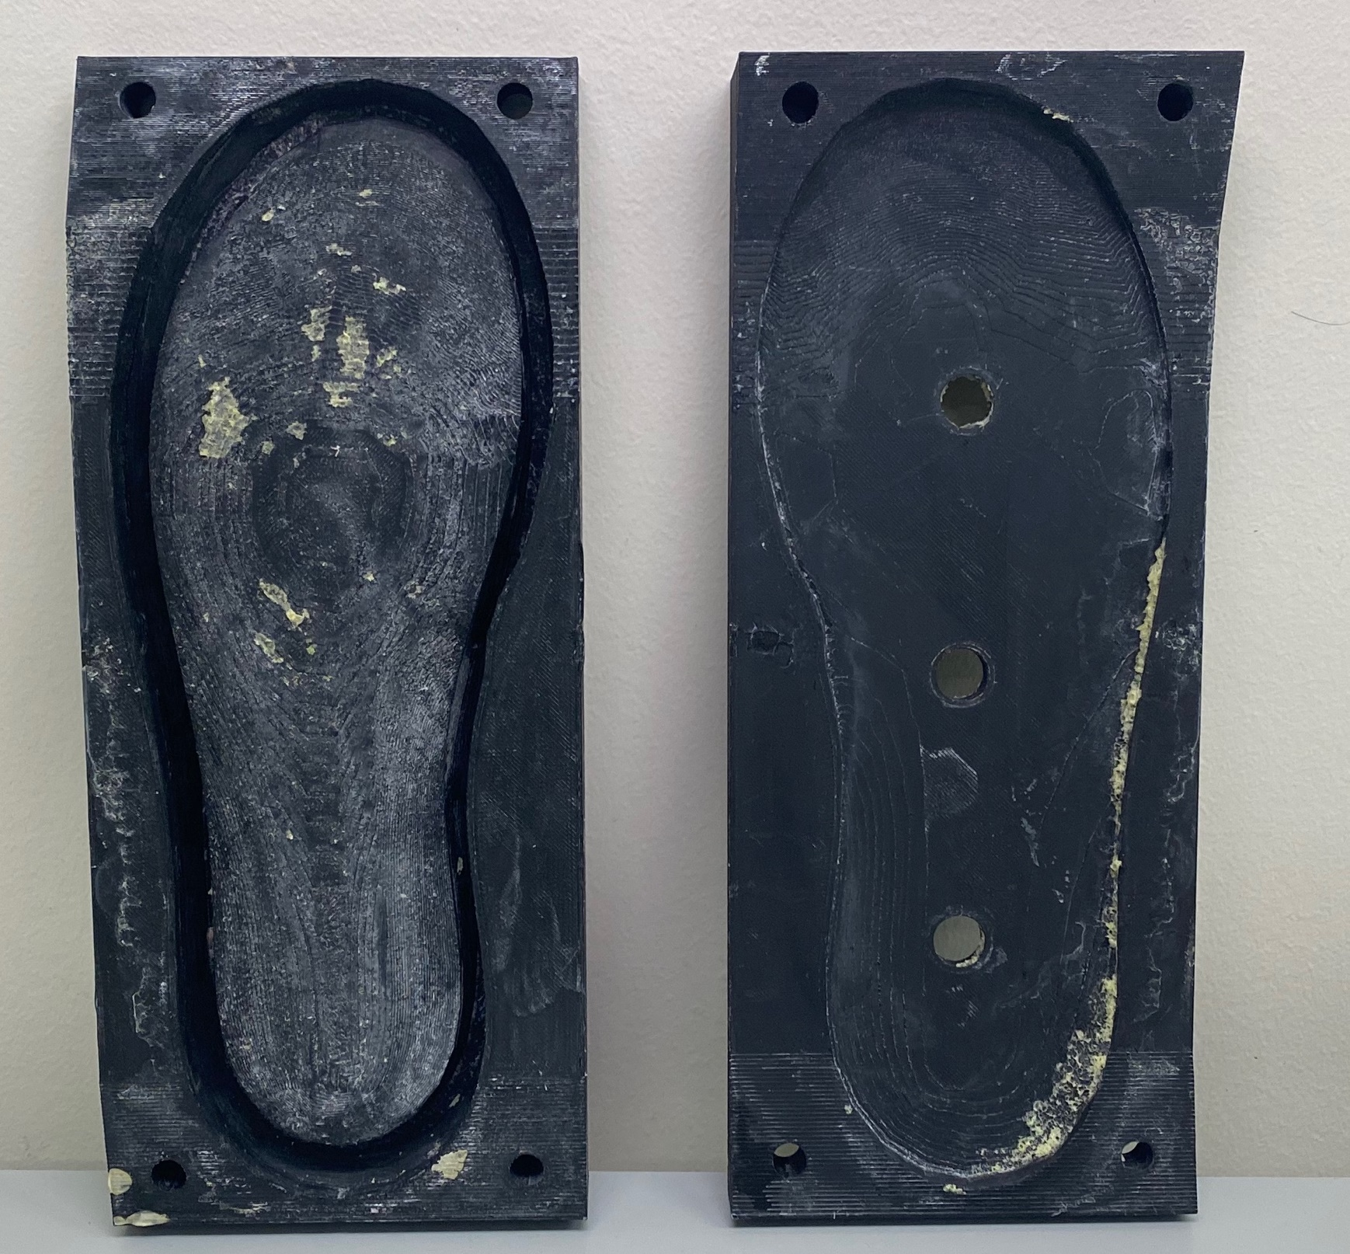
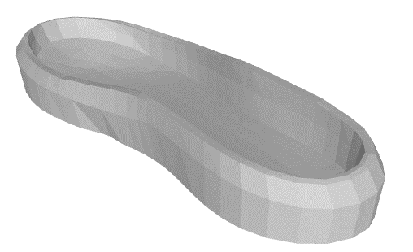
Sole
Provided by U Oregon to match the last
3D printed mold to cast sole with Smooth-On Flex Form-it 17

Slide 52
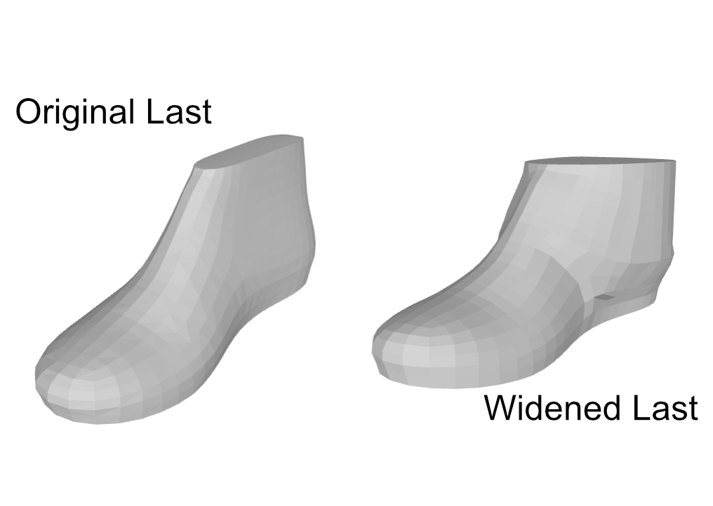
Last Modifications
Male size 9 hiking last provided by U Oregon
Last ankle widened to 375mm circumference for donning/doffing

Slide 53
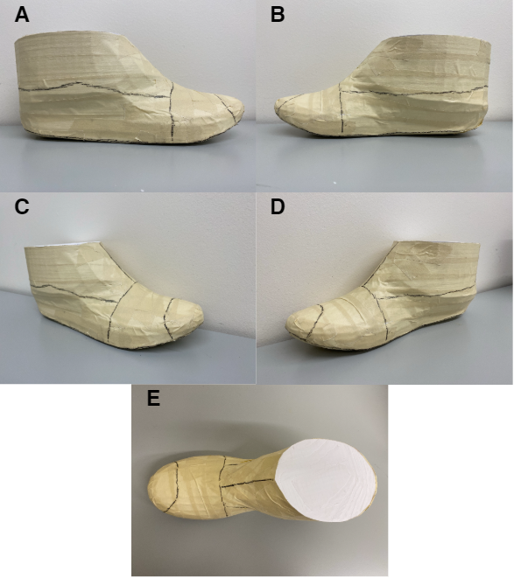
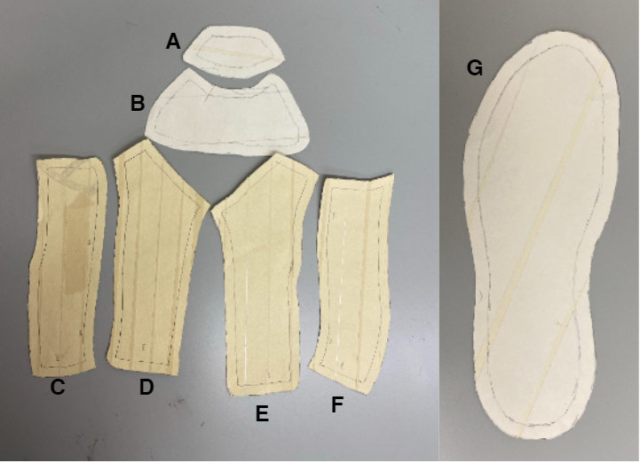
Last Patterning
Last taping procedure¹:
¹W. Motawi, Footwear Pattern Making and Last Design. Walid Motawi, 2020.

Slide 54
Lacing Design
BOA H4 system chosen for strength
Convolute runs from MTP joint back to allow for pivot
40mm of vertical adjustment at heel
Lacing tightens pivot to secure foot, further tightens during heel-off

Slide 55
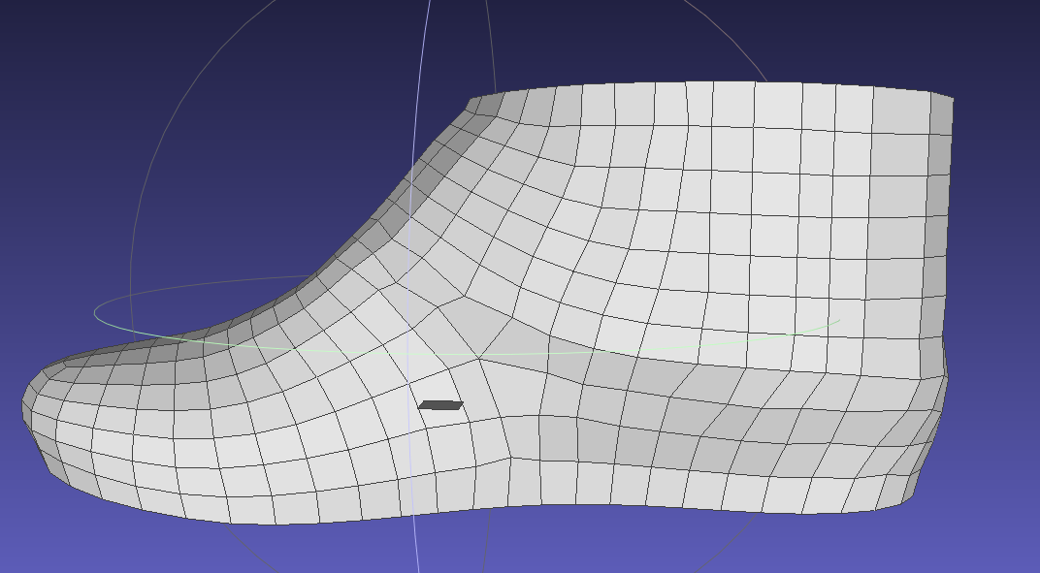
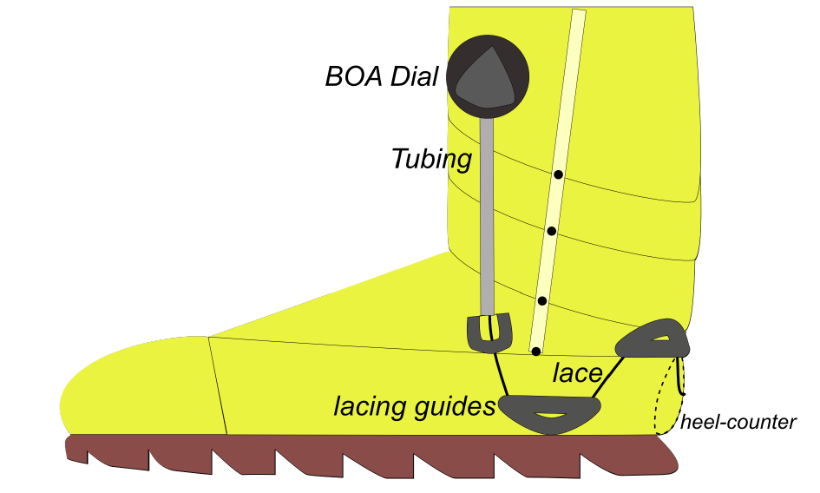
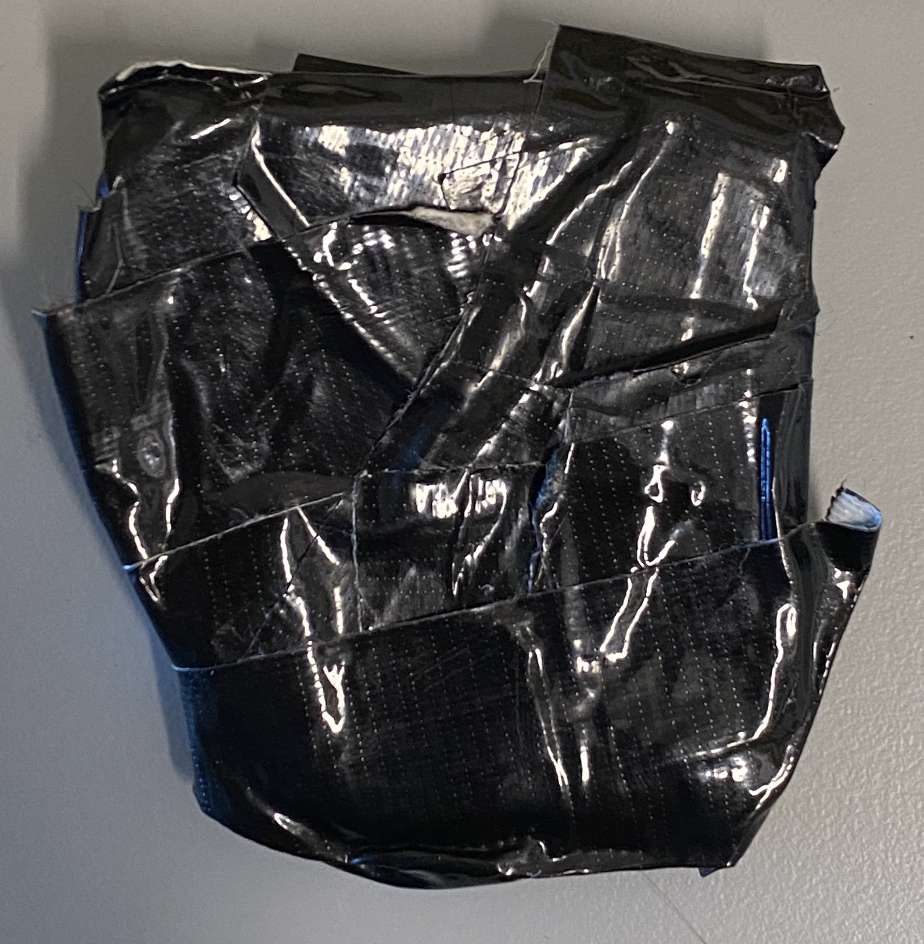
Heel Counter
Rearmost BOA dial acts as heel-counter
Additional internal heel counter molded based on last shape

Slide 56
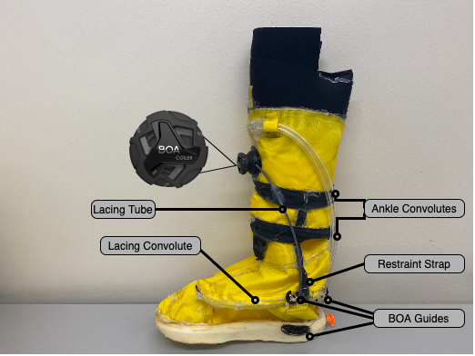
Novel Spaceboot Prototype

Slide 57
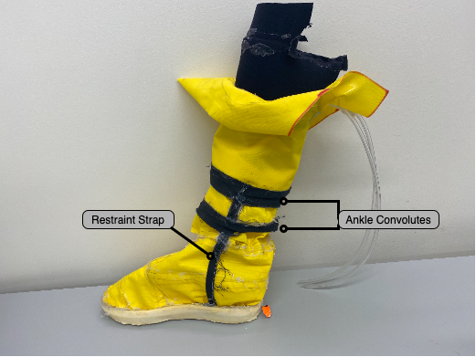
Classic Spaceboot Prototype
Comparison classic spaceboot prototype for design evaluation
Straight ankle convolutes, no lacing, identical sole

Slide 58


Pressurization Interface
Neoprene layer attached to convolute assembly
Layers of straps to minimize air leaks between boot and calf
Pressurization of 2.7 ± 0.3 psi

Slide 59
Summary
Framework generated to incorporate foot shape information into footwear design process
Novel spaceboot design with lacing and heel counter to accommodate foot shape changes and reduce heel lift
Design translated into functioning pressurized prototype

Slide 60
Specific Aim 4
Evaluate novel planetary spacesuit boot design for fit and comfort

Slide 61
Testing Hypotheses
The novel spaceboot design will provide:
equivalent comfort compared to the laced workboot
improved comfort compared to the classic spaceboot and unlaced work boot
The novel spaceboot design will provide:
equivalent heel performance as the laced workboot boot
Improved heel performance compared to the classic spaceboot and unlaced work boot

Slide 62
Subjects
5 Subjects
US Male 8-10 Self-Reported shoe size
Foot length: 25.7±0.4 cm
3 M/2 F
Procedures
5 heel-raises, as slowly as possible
Short walk

Slide 63




Test Conditions (Right)
Novel Spaceboot
Laced Workboot
Classic Spaceboot
Unlaced Workboot

Slide 64

Control Condition (Left)
Sneaker

Slide 65


Survey Measurements
Heel Performance
1: like flip-flop, 10: like tennis shoe
Corlett-Bishop Discomfort for below knee
Rating of Perceived Exertion

Slide 66




Quantitative Measurements
Heel-raise height measured with cameras and Kinovea software
Heel-raise difference between left and right
Heel-off time difference between left and right
Marker (circled in blue) tracked with Kinovea for heel-rise magnitude

Slide 67





Quantitative Measurements
Force Sensitive Resistor (FSRs):
Mounted underneath heel in all boots
0V: Full contact, 3.3V: No contact
FSR Voltage at max heel-rise
FSR Voltage at heel-off
FSRs embedded in sole of spaceboots (left) and workboots (right)

Slide 68

Bayesian Linear Regression Analysis
Use a linear model to assess the performance of each boot for each metric, controlling for subject-specific effects
$$metric=β_{shoe}x_{i}+α_{subject}^{n}+σ$$
$β_{shoe}$ = effect of each footwear condition ($x_{i})$ on the metric
$α_{subject}^{n}$= $n$ subject specific intercepts
$σ$ = unexplained error in model

Slide 69

Bayesian Linear Regression Analysis
Since each footwear condition is a categorical variable:
$$metric =β_{novel spaceboot}+β_{laced workboot}+β_{classic spaceboot}+β_{unlaced workboot}+α_{subject}^{n}+σ$$
Bayesian linear regression will provide us with an estimate for each $β$ and $α$
Allows for meaningful prior
Does not assume subject specific effects are normally distributed

Slide 70
Heel Performance Score - Analysis
Set meaningful prior:
Boot condition = Uniform(1,10)
Define model:
Heel Performance Score = Boot Condition + (1 | Subject)
Use Markov Chain Monte Carlo to explore possible values for each model parameter
PyMC3 and Bambi Python libraries

Slide 71


Heel Performance Score - Analysis
Posterior distributions for each parameter are then analyzed:
Maximal Posterior Estimate: most likely value from distribution
Bayesian Credible Interval: interval which represents the parameter’s estimated value in x% of simulations
Parameter overlap: What is the chance one parameter’s value is higher?

Slide 72

Heel Performance Score - Results
Novel spaceboot is lower than laced workboot, but higher than classic spaceboot and unlaced workboot

Slide 73

Rating of Perceived Exertion - Results
Novel spaceboot is higher than laced workboot and unlaced workboot, but lower than classic spaceboot
Notes:
Summarize corlett-bishop on this slide

Slide 74

Heel Rise Difference - Results
Novel spaceboot is similar to laced workboot, but lower than classic spaceboot and unlaced workboot
Notes:
Only talk in detail about Heel rise difference and FSR value at heel-rise, summarize others

Slide 75

Heel-Off Time Difference - Results
Novel spaceboot has less heel-off time-difference than laced workboot, classic spaceboot, and unlaced workboot
Right-side lifts first
Left-side lifts first

Slide 76

FSR at Heel-Off - Results
Novel spaceboot has lower chance of contact than laced workboot, but higher chance of contact than classic spaceboot and unlaced workboot

Slide 77

FSR Maximum Voltage - Results
Novel spaceboot has higher chance of contact than laced workboot, classic spaceboot, and unlaced workboot

Slide 78

Discomfort Results
Pressurized boots had higher discomfort than non-pressurized boots

Slide 79


Summary
Both the novel spaceboot and laced workboot appear to maintain contact with the heel at heel-off, but novel spaceboot continues to maintain contact through heel-raise
Subjects still ranked laced workboot as best for heel performance
Novel spacesuit boot is clear improvement over classic spacesuit boot and unlaced workboot

Slide 80
Research Summary

Slide 81
Contributions
Showed drawbacks of using IMUs to detect instances of heel-lift and identified alternative methods to explore in future work
Gap: Few efforts to quantify fit discrepancies
A novel software library to use multiple commercial depth cameras as a cost-effective 4D scanner, capable of collecting body shape changes at 90 frames-per-second
Gap: Limited knowledge on dynamic body shape changes due to motion
A parametric statistical shape model that predicts dynamic foot shape during stance phase as a function of anthropometry and kinematics
Gap: Limited knowledge on dynamic body shape changes due to motion
A design framework integrating dynamic foot shape knowledge with known foot mobility to design a novel spacesuit boot to improve fit and comfort
Gap: No existing framework for incorporating dynamic body-shape models into the spacesuit design and fit process

Slide 82
Contributions
Quantification of dynamic changes in instep height and instep girth as they relate to their distribution in the global population
Gap: Limited knowledge on dynamic body shape changes due to motion
A novel spacesuit boot prototype developed from the framework that aims for better fit and comfort, and specifically a reduction in heel-lift
Gap: No existing framework for incorporating dynamic body-shape models into the spacesuit design and fit process
Evaluation of the novel spacesuit boot for fit and comfort
Gap: No studies to quantify the effect of using body-shape models over linear measurements on fit and comfort

Slide 83
Hypothesis
Integrating dynamic body shape changes into the spacesuit boot design process will mitigate factors that lead to injury and improve compatibility between the operator and the spacesuit.

Slide 84
Hypothesis
Integrating dynamic body shape changes into the spacesuit boot design process will mitigate factors that lead to injury and improve compatibility between the operator and the spacesuit.
SA2 models dynamic foot shape changes

Slide 85
Hypothesis
Integrating dynamic body shape changes into the spacesuit boot design process will mitigate factors that lead to injury and improve compatibility between the operator and the spacesuit.
SA3 incorporates dynamic foot morphology changes, along with existing knowledge of footwear design and foot mobility into a design framework used to develop a novel spacesuit boot design

Slide 86
Hypothesis
Integrating dynamic body shape changes into the spacesuit boot design process will mitigate factors that lead to injury and improve compatibility between the operator and the spacesuit.
SA1 suggested a heel-contact sensor to directly measure heel-lift
SA4 evaluated the novel boot design for its comfort and heel performance

Slide 87
Peer-Reviewed Publications
TYPE | TITLE | JOURNAL | Date | Specific Aim
Technical Note | Detecting Heel-Lift in Spacesuit Gait | Aerospace Medicine and Human Performance | Jan 2022 (under review) | SA1
Journal Paper | DynaMo: Dynamic Body Shape and Motion Capture with Intel RealSense Cameras | Journal of Open Source Software | Sept 2019 | SA2
Journal Paper | Dynamic foot morphology explained through 4D scanning and shape modeling | Journal of Biomechanics | June 2021 | SA2
Conference Paper | A Biomechanical Design Framework to Improve Spacesuit Boot Fit | 50th International Conference on Environmental Systems | July 2020 | SA3
Journal Paper | Static and Dynamic Distribution of Instep Height | Footwear Science | Jan 2022 (under review) | SA2
Journal Paper | Design and Evaluation of a Novel Planetary Spacesuit Boot | Nature Microgravity | May 2022 | SA3/SA4
Key:
Planned
In Progress
Completed
Notes:
Use blue-yellow-green scheme to show progress

Slide 88
Conference Presentations
TYPE | TITLE | CONFERENCE | DATE | Specific Aim
Talk | Using dynamic foot morphology data to design spacesuit footwear (Martyn Shorten Award For Innovation) | Footwear Biomechanics Symposium | July 2019 | SA2
Talk | Development of a Dynamic 3D Scanning System with Multiple Intel RealSense Depth Cameras | International Society of Biomechanics Congress | Aug 2019 | SA2
Poster | Quantifying the Heel Lift during Spacesuit Gait | NASA HRP IWS | Jan 2020 | SA1
Poster | Dynamic Body-Shape Models to Reduce Risk Of EVA Spacesuit Injury (Student Poster Competition Winner) | NASA HRP IWS | Feb 2021 | Overall
Poster | Using Dynamic Foot Shape Models to Design a Better Spacesuit Boot (Student Poster Competition Winner) | International Conference on Environmental Systems | July 2021 | SA3
Talk | Novel Spacesuit Boot Design Developed from Dynamic Foot Shape Modeling | Footwear Biomechanics Symposium | July 2021 | SA3
Talk | Statistical Dynamic Foot Shape Model | American Society of Biomechanics | Aug 2021 | SA2
Key:
Completed
Notes:
Retitle to confrerence presentations
Add ICES conference poster

Slide 89
Acknowledgements
CU Boulder Bioastronautics Students and Faculty
Ella Schauss, Young-Young Shen, Katya Arquilla
CU Boulder Biomechanics Group
Rodger Kram, Wouter Hoogkamer, Ryan Alcantara, Alena Grabowski
MIT Human Systems Lab
Leia Stirling, Richard Fineman, Tim McGrath
Steven Priddy – CU Boulder Aerospace Engineering
Shane McFarland – NASA JSC Advanced Suit Lab
Shane Jacobs – David Clark
BOA Technology
Brett Vladika, Dan Feeney, Anna Hetman
Matthew Reed – University of Michigan Transportation Research Institute
University of Oregon Portland Sports Product Design Program
Alex Xu, Susan Sokolowski
Ales Jurca – Volumental AB
Funding
NSF Graduate Research Fellowship (Grant #: DGE 1650115)
Smead Scholars

Slide 90



Slide 91
Planetary Exploration Benefits
2020 NASA Technology Taxonomy TX06.2.1 defines the spacesuit as a complex system of soft-goods and mobility elements to optimize performance while pressurized without inhibiting unpressurized operations
Planetary exploration requires safe and comfortable spacesuits to enable successful EVA
Boot design framework presented in this thesis will allow for the planetary exploration boots which reduce instances of heel-lift over current spacesuit boots
Thesis can be expanded in future work for other spacesuit components with high injury risk, such as gloves and the hard upper torso

